Slide 1

ML Process
Pipeline Trigger - Scheduled / On ML Model Drift
Business Challenge
ML Problem Scoping
Data Scientist Manual Trigger
Data Collection
EDA
Inference Data Logging
Model Monitoring
Pipeline
Data PreProcessing
Feature Engineering
ML Modeling
Accepted ?
Model Validation
Versioning (Model/ Data/Code )
Model Deployment

Slide 2


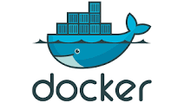
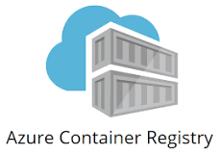




ML Architecture - Azure + OpenAI
Azure
Input Data (Data Lake, RDS, Feature Store)
Client / Users
Deploy image to Azure App Service
Push image to Registry
Flask server + Prompt / Completion Call Docker Image
Azure ML Workspace
Notebook
AutoML
Code
Data Scientist
Model
Deploy
Model
Rest API orAzure Cli
Notes:
Model Registry : View and Compare models (Like dashboard for models. Model artifacts are stored in s3)

Slide 3
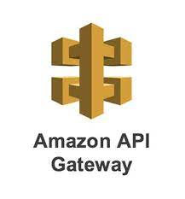
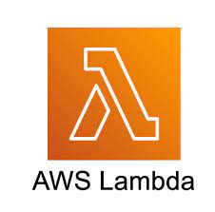
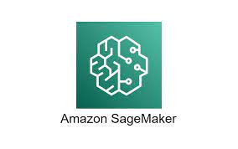
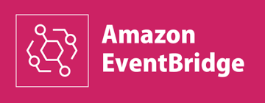
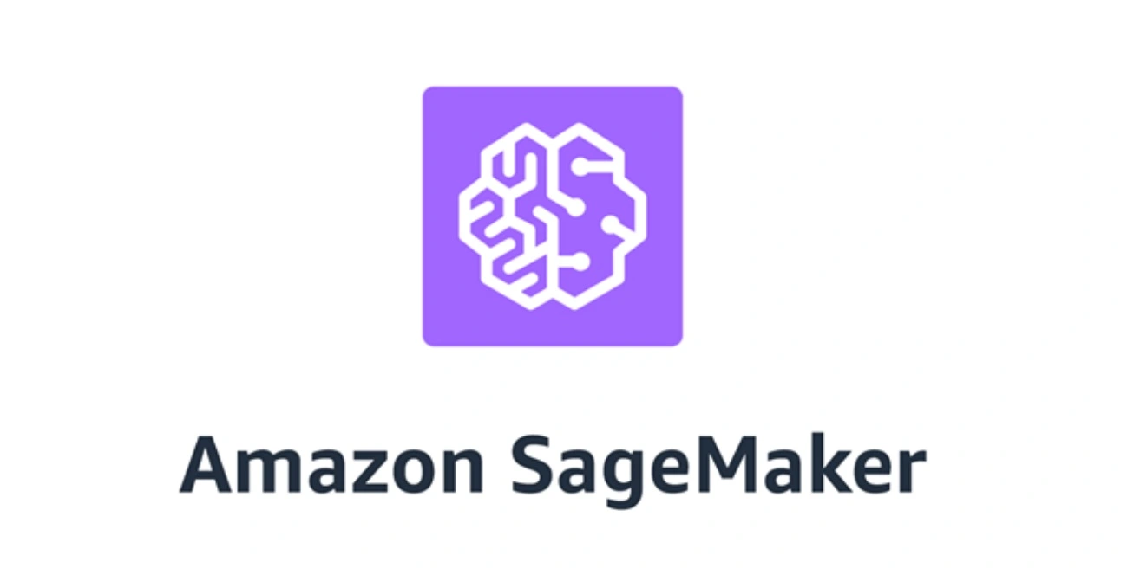


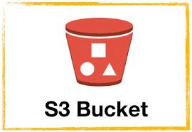
ML Architecture - AWS (Excluding Staging / Dev / Prod Separate Deployment Separate Setup Arch)
AWS
AWS AutoScaling Group
Input Data (S3, RDS, Redshift, Glue)
Inference Data (S3, RDS)
Sagemaker Endpoint
Client / Users
SageMaker Model/ Data Drift Monitor
Fetch/ Update Endpoint on Approval
Scheduled or Drift Triggered
SageMaker Model Registry
Code
SageMaker Notebook
Sagemaker Pipeline
Docker Containers
Pre-Processing
Model Training
Data Scientist
Models
Notes:
Model Registry : View and Compare models (Like dashboard for models. Model artifacts are stored in s3)

Slide 4
ML Deployment Arch (Rough Outline)
Fully Self-Managed ML Environment
1. Model Serialisation : (Pickle ) 2. Web Server : (Flask) - To provide web access to model. - Model Deserialisation/ Pipeline/ Inference code integration to Flask 3. Containerisation : (docker/ packer) - Package libraries, dependencies here - Self–Contained deployable images created - Fetch latest codes from git - Auto-refresh models from s3 - Connect to DB(Amazon RDS- for data storage) 4. Deployment : (BitBucket Pipeline / TerraForm) - Deploy to AWS EC2/ GCP instances/ any cloud - Multiple prod instances (scalability) 5. Load Balancer : - AWS load balancer to balance load between prod servers
SageMaker
0. Model Trained & Deployed to Sagemaker - Direct deployment from notebook available
1. API Rest EndPoint ( Prediction Request (JSON) received here) 2. AWS lambda - 2 way communication with Sagemaker Inference API Endpoint - Pre-Inference : - Pre inference Custom Logic not in ML serialised object can be added here - Data can be logged to DB here - Post_inference : - All steps post receiving here - Prediction received post-process here, if needed
3. Amazon Sagemaker Inference EndPoint
PS: Due to time constraint, I have provided rough arch outline. I may be able to make detailed & arch diagram and upload it to git later.

